Slide 1
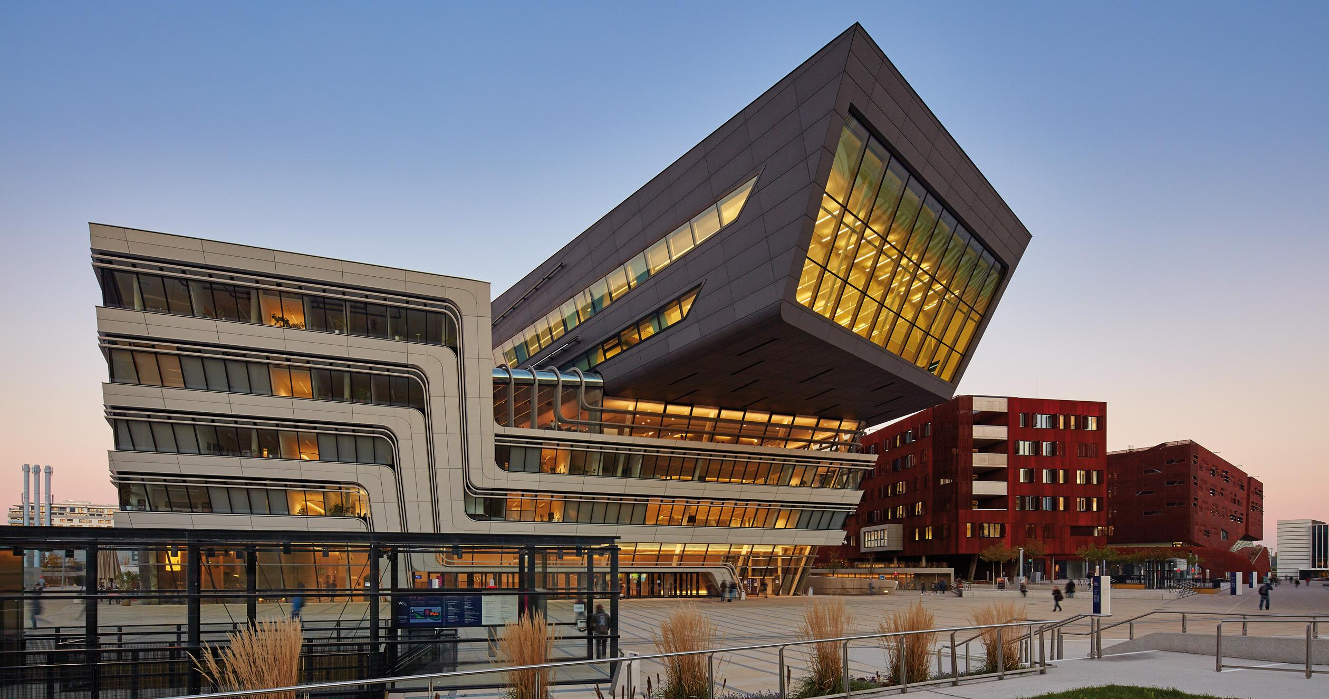
How to update the license of multiple portfolios in batch mode
Yoel Kortick | Senior Librarian
https://www.wien.info/en/sightseeing/architecture-design/wu-campus

Slide 2










Introduction
Create a set of the portfolios
Update the license in the set of the portfolios
Confirm that the portfolio license has been updated
five
six
seven
http://asm.easternhealth.sg/2014/images/banner-agenda.jpg

Slide 3
Introduction
This presentation shows a situation where the institution needs to update selected portfolios from an electronic collection and change the license of the portfolios.
The steps are:
Create a set of the portfolios which you want to change
Run the job “Change electronic portfolio information” on the set and update the license

Slide 4
Introduction
There are many ways to create the set. See here: https://knowledge.exlibrisgroup.com/Alma/Product_Documentation/Alma_Online_Help_(English)/Administration/070Managing_Jobs/Managing_Search_Queries_and_Sets
In the example here we create a set using an Excel sheet from the electronic service editor of the electronic collection
The set can of course also be made for portfolios belonging to different electronic collections or to no electronic collections

Slide 5
Introduction
Create a set of the portfolios
Update the license in the set of the portfolios
Confirm that the portfolio license has been updated
five
six
seven
http://asm.easternhealth.sg/2014/images/banner-agenda.jpg

Slide 6
Create a set of the portfolios
The first step is to create a set of the portfolios for which you want to update the license.
If for example the portfolios are a selected group of portfolios all belonging to the same collection then you could
Export the list of portfolios to an excel sheet
Remove the lines which you do not want to update
Create an itemized set of the portfolios

Slide 7
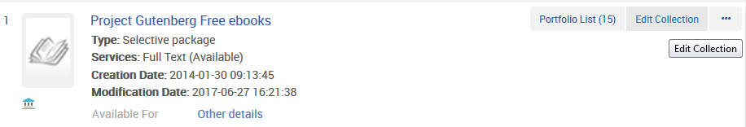
Create a set of the portfolios
For example search for electronic collection and click ‘edit collection’

Slide 8
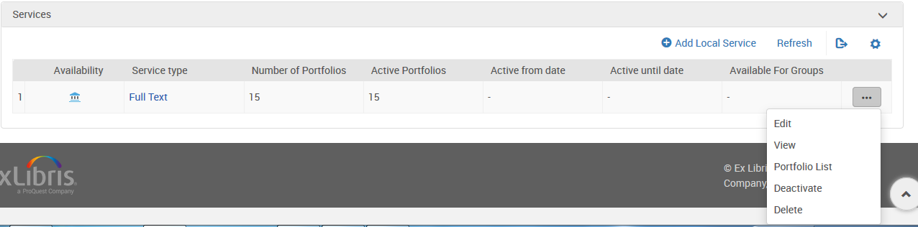
Create a set of the portfolios
Switch to ‘Additional Information’ tab and scroll down to the service and go to the portfolio list

Slide 9
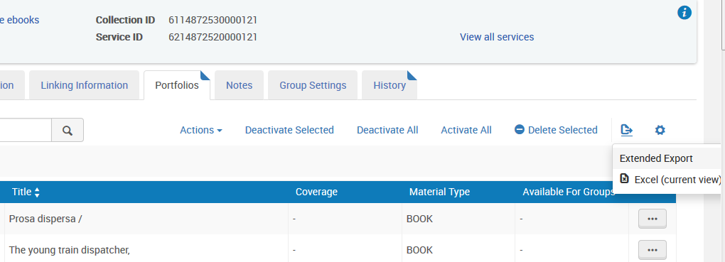
Create a set of the portfolios
Export to “Extended report” Excel

Slide 10
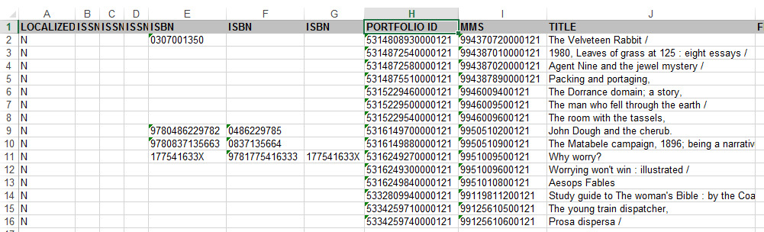
Create a set of the portfolios
In resulting Excel remove the lines you do not want to update and change header PORTFOLIO_PID to “PORTFOLIO ID” or “PID”

Slide 11
Create a set of the portfolios
Do ‘Admin > Manage Jobs and Sets > Manage Sets > Add Set > Itemized ’
Choose ‘Set Content Type = Electronic Portfolios’
Give the set a name and upload the Excel sheet

Slide 12
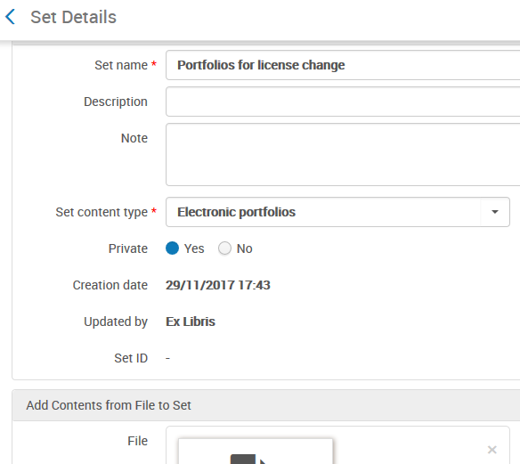
Create a set of the portfolios

Slide 13
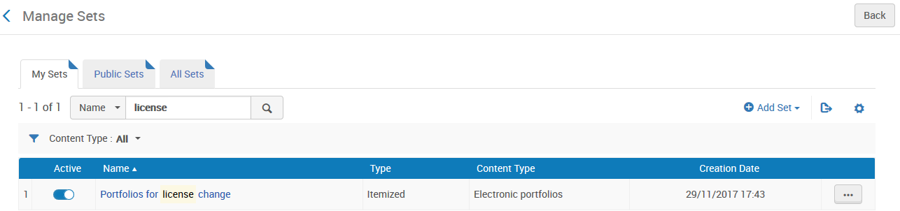
Create a set of the portfolios
Now you have a set of portfolios

Slide 14
Introduction
Create a set of the portfolios
Update the license in the set of the portfolios
Confirm that the portfolio license has been updated
five
six
seven
http://asm.easternhealth.sg/2014/images/banner-agenda.jpg

Slide 15
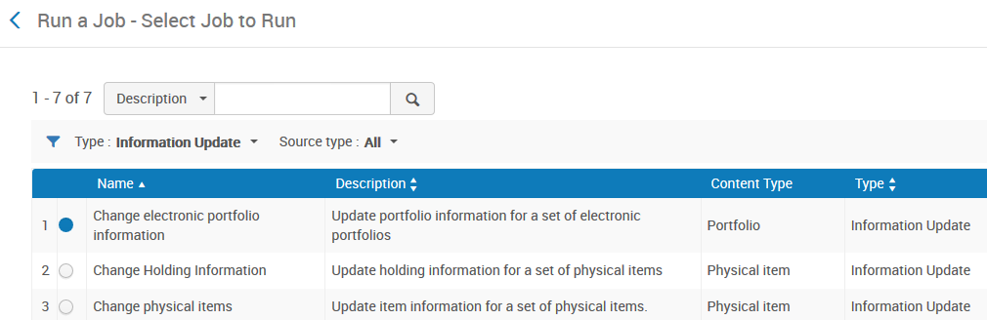
Update the license in the set of the portfolios
Do “Admin > Manage Jobs and Sets > Run a Job”
Filter by “Information Update”
Choose “Change electronic portfolio information”

Slide 16
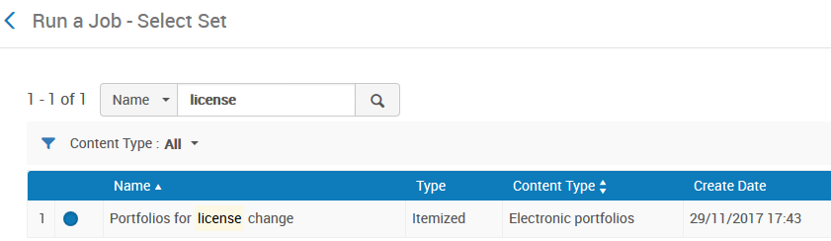
Update the license in the set of the portfolios
Select the desired set of portfolios to change

Slide 17
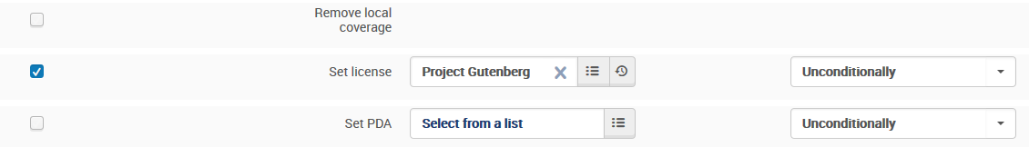
Update the license in the set of the portfolios
Set the license as desired

Slide 18
Introduction
Create a set of the portfolios
Update the license in the set of the portfolios
Confirm that the portfolio license has been updated
five
six
seven
http://asm.easternhealth.sg/2014/images/banner-agenda.jpg

Slide 19
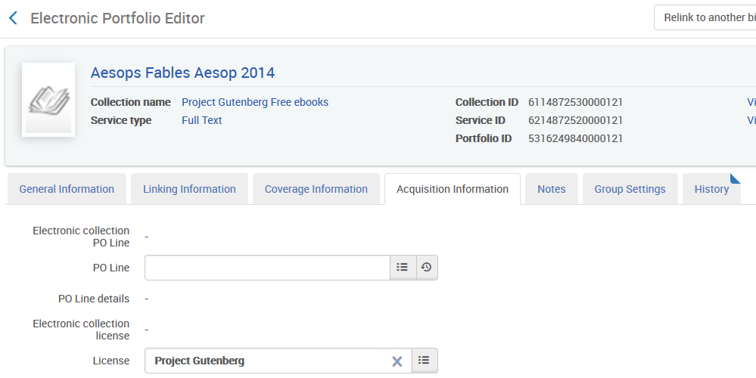
Confirm that the portfolio license has been updated
See that the portfolios from the set now have the license

Slide 20
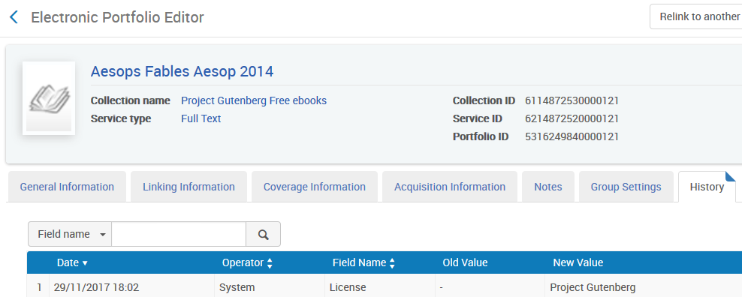
Confirm that the portfolio license has been updated
See that the portfolios got the license from the running of the job

Slide 21
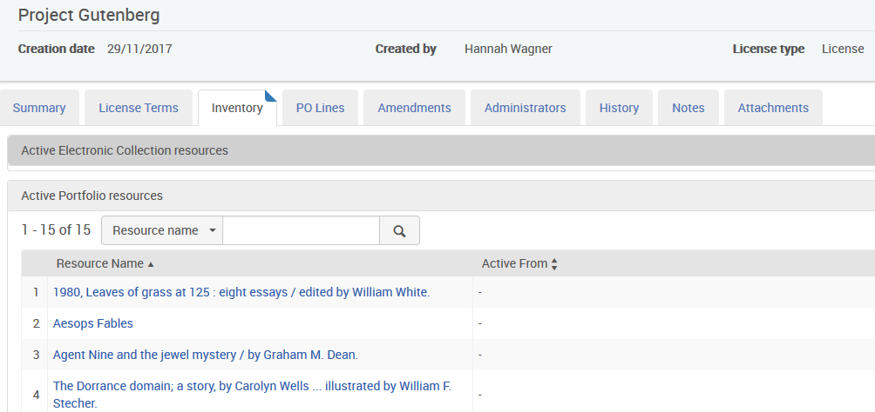
Confirm that the portfolio license has been updated
You can also see the licenses of the portfolios in the inventory tab of the license

Slide 22
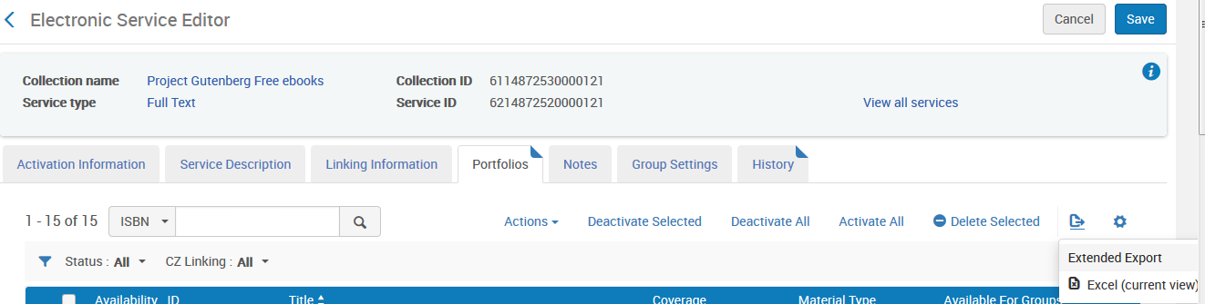
Confirm that the portfolio license has been updated
You can also see the licenses of the portfolios in the extended report printed from the portfolio list of the Electronic Service Editor

Slide 23
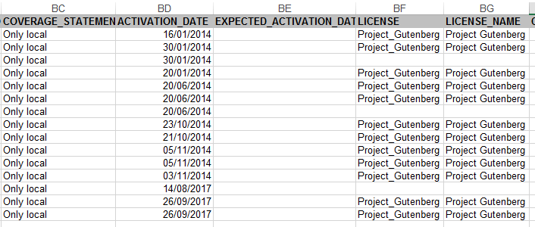
Confirm that the portfolio license has been updated
You can also see the licenses of the portfolios in the extended report printed from the portfolio list of the Electronic Service Editor

Slide 24
Thank You
https://www.wien.info/en/sightseeing/architecture-design/wu-campus

